Slide 1
GeoHumanities’19
3rd ACM SIGSPATIAL Workshop on Geospatial Humanities
5th Nov. 2019 – Holiday Inn at the Mart Plaza, Chicago, Illinois, USA
Opening Remarks – Bruno Martins and Ludovic Moncla

Slide 2
Organizers
http://bgmartins.github.io/sigspatial-geohumanities/

Slide 3
http://bgmartins.github.io/sigspatial-geohumanities/

Slide 4
GeoHumanities’19
Workshop concerned with the use of geographic information systems and other spatial technologies in humanities research
We received 8 submissions, of which we accepted 6 papers for presentation at the workshop
Program Committee with 30 researchers (different backgrounds)
Workshop program contains 2 technical sessions
coffee breaks in between sessions + lunch after the 2nd session
discussion session at the end
Details on the website - http://bgmartins.github.io/sigspatial-geohumanities/

Slide 5
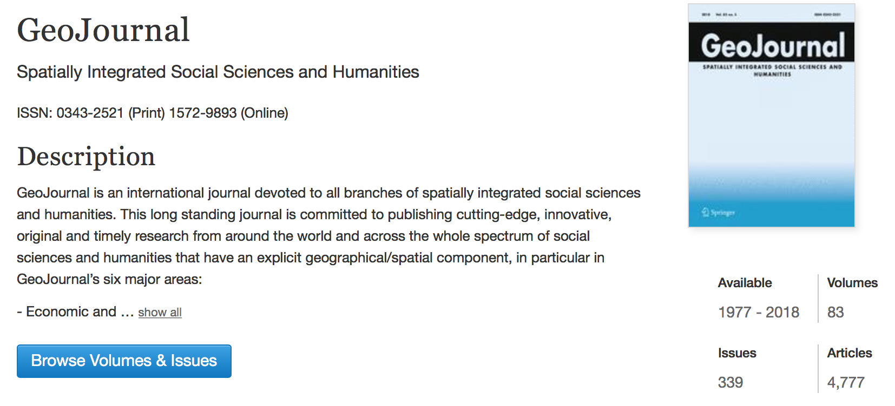
Special Issue at GeoJournal

Slide 6
Session 1
09:15 - 09:40 - Mawo Kamakura, Hikaru Ikuta, Bo Zheng, Yoshihiro Sato, Masataka Kagesawa, Takeshi Oishi, Kaoru Sezaki, Takeshi Nakagawa and Katsushi Ikeuchi.
Preah Vihear Project: Obtaining 3D point-cloud data and its application to spatial distribution analysis of Khmer temples
09:40 - 10:05 - Xiao Huang, Cuizhen Wang and Zhenlong Li.
High-Resolution Population Grid in the CONUS Using Microsoft Building Footprints: A Feasibility Study
10:05 - 10:30 - Rachel Palumbo, Laura Thompson and Gautam Thakur.
SONET: A Semantic Ontological Network Graph for Managing Points of Interest Data Hetereogeneity

Slide 7
Session 2
11:00 - 11:25 - Clio Andris, Brynne Godfrey, Carleen Maitland and Matthew McGee.
The Built Environment and Syrian Refugee Integration in Turkey: An Analysis of Mobile Phone Data
11:25 - 11:50 - Ludovic Moncla, Katherine McDonough, Denis Vigier, Thierry Joliveau and Alice Brenon.
Toponym disambiguation in historical documents using network analysis of qualitative relationships
11:50 - 12:15 - Jimin Wang and Yingjie Hu.
Are We There Yet? Evaluating State-of-the-Art Deep Learning Geoparsers Using EUPEG as a Benchmarking Platform

Slide 8
GeoHumanities’19
Proceedings of the 3rd ACM SIGSPATIAL Workshop on Geospatial Humanities are now available from the ACM Digital Library
https://dl.acm.org/citation.cfm?id=3356991

Slide 9
Wrap up questions…
What are some components that could be added to GeoHumanities workshop?
What are the core set of skills for the students who would like to build expertise in GeoHumanities?
Any other aspects that can make GeoHumanities as a workshop and an interdisciplinary field better?

